Slide 1
Lead Score Case Study

Slide 2
Lead score case study for X education
Problem Statement :
X Education sells online courses to industry professionals.The company markets its courses on several websites and search engines like Google. Once these people land on the website, they might browse the courses or fill up a form for the course or watch some videos.When these people fill up a form providing their email address or phone number, they are classified to be a lead. Moreover, the company also gets leads through past referrals.
Once these leads are acquired, employees from the sales team start making calls, writing emails, etc. Through this process, some of the leads get converted while most do not.The typical lead conversion rate at X education is around 30%.
Business Goal :
X Education needs help in selecting the most promising leads, i.e. the leads that are most likely to convert into paying customers.
The company needs a model wherein you a lead score is assigned to each of the leads such that the customers with higher lead score have a higher conversion chance and the customers with lower lead score have a lower conversion chance.
The CEO, in particular, has given a ballpark of the target lead conversion rate to be around 80%.

Slide 3
Strategy
Source the data for analysis
Clean and prepare the data
Exploratory data analysis
Feature scaling
Splitting the data into Test and Train dataset
Building a logistic Regression and Calculate Lead score
Evaluating a model by using different metrics specificity and Sensitivity or Precision and Recall
Applying the best model in Test data based on the Sensitivity and Specificity Metrics

Slide 4
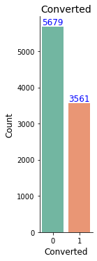
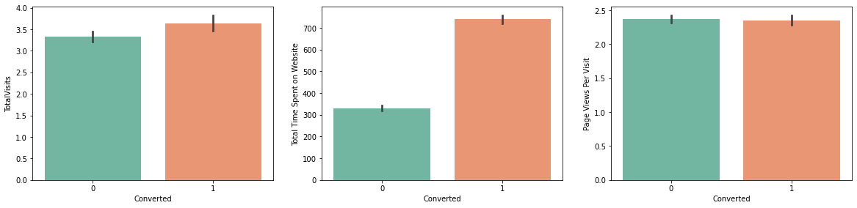
Problem solving methodology
We have around 39%
Conversion Rate in total
Conversion rate were high for Total visits, Total Time spent on website and Page Views Per Visit

Slide 5
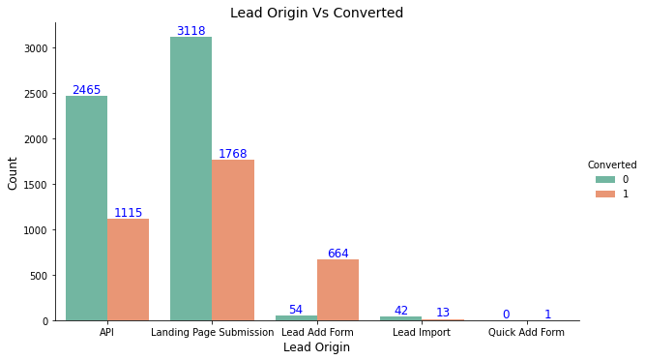
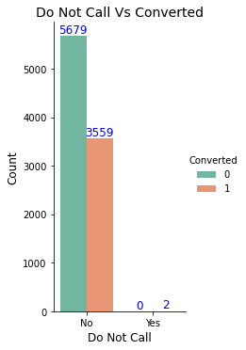
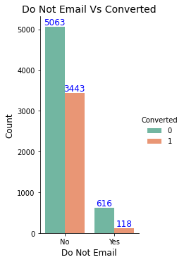
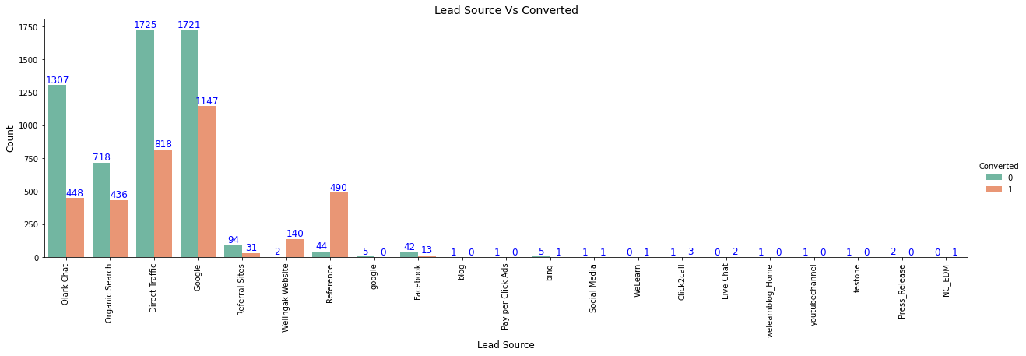
In lead origin, maximum conversion happened from Landing Page Submission
Major conversion has happened from Emails sent and calls Made
Major Conversion in the lead source is from Google

Slide 6
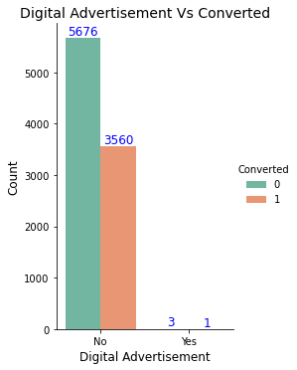
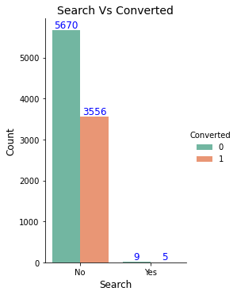
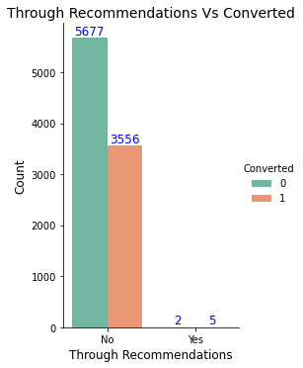
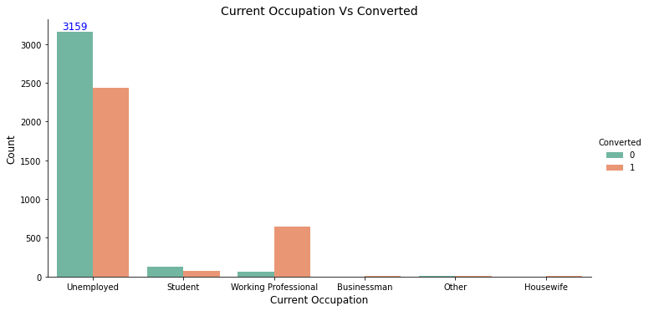
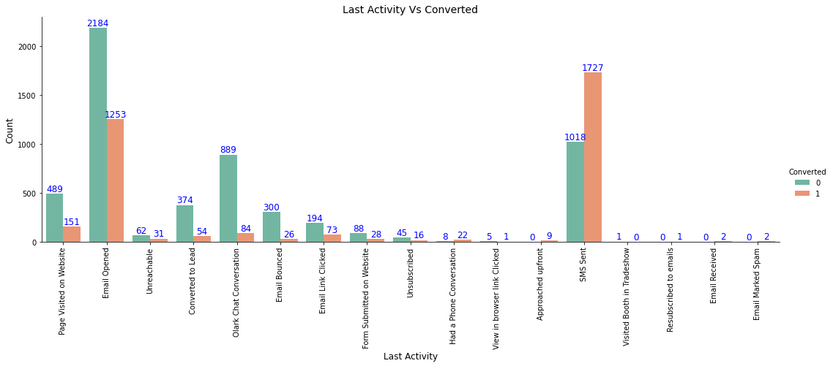
Not much impact on conversion rates through Search, digital advertisements and through recommendations
More conversion happened with people who are unemployed
Last Activity value of SMS sent had more conversion

Slide 7
Variables Impacting the Conversion Rate
Do not Email
Total visits
Total time spent on website
Lead origin - Lead page submission
Lead Origin - Lead Add form
Lead source - Olark chat
Lead source - Welingak Website
Last Activity - Not Sure
Last Activity - Email Bounced
Last Activity - Olark chat conversion
Last Activity - SMS sent
Current Occupation - No Information
Current Occupation - Working Professional
Last Notable Activity - Had a phone conversation
Last Notable Activity - Unreachable

Slide 8
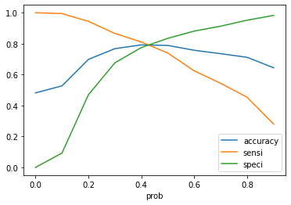
The graph depicts an optimal cut off based on accuracy, Sensitivity and Specificity
Confusion Matrix
1823
479
444
1705
Accuracy - 0.79
Sensitivity - 0.79
Specificity - 0.78
FPR - 0.21
Positive predictive value - 0.77
Negative predictive value - 0.88

Slide 9
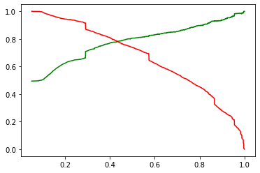
The graph depicts an optimal cut off of 0.42 based on Precision and Recall
Confusion Matrix
1852
460
479
1670
Precision - 0.72
Recall - 0.78

Slide 10
Model Evaluation - Sensitivity and Specificity on Test Dataset
Confusion Matrix
Accuracy - 0.78
Sensitivity - 0.76
Specificity - 0.80
801
195
213
703

Slide 11
Conclusion
While we check both specificity and sensitivity as well as Precision and Recall metrics, we have considered the optimal cut off based on sensitivity and specificity for calculating the final prediction.
Accuracy,Specificity and sensitivity values of test set are around 0.78, 0.76 and 0.80 which are approx closer to the respective values calculated using trained set
Also the lead score calculated shows the conversion rate on the final predicted model is around 80% and 79% for train and test sets respectively.
The Top three variables that contribute for lead getting converted in the model are.
Total time spent on website
Lead Add form from Lead Origin
Had a Phone Conversation from Last Notable Activity
Hence overall this model seems to be good.

